Slide 1
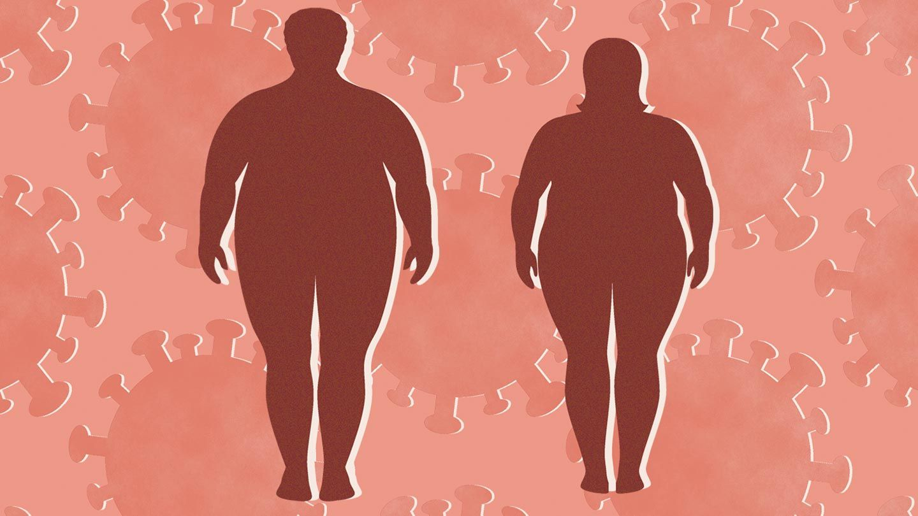
Over weight
Why being over weight is a problem
Obesity is a complex health issue resulting from a combination of causes and individual factors such as behaviour and genetics. Behaviours can include physical activity, inactivity, dietary patterns, medication use, and other exposures. Additional contributing factors include the food and physical activity environment, education and skills, and food marketing and promotion.
Obesity is serious because it is associated with poorer mental health outcomes and reduced quality of life. Obesity is also associated with the leading causes of death in the United States and worldwide, including diabetes, heart disease, stroke, and some types of cancer.
A steady weight loss of 1 to 2 pounds per week is recommended for the most effective long-term weight management.That said, many eating plans leave you feeling hungry or unsatisfied. These are major reasons why you might find it hard to stick to a healthier eating plan.However, not all diets have this effect. Low carb diets and whole food, lower calorie diets are effective for weight loss and may be easier to stick to than other diets. Here are some ways to lose weight that employ healthy eating, potentially lower carbs, and that aim to:
A steady weight loss of 1 to 2 pounds per week is recommended for the most effective long-term weight management. That said, many eating plans leave you feeling hungry or unsatisfied. These are major reasons why you might find it hard to stick to a healthier eating plan. However, not all diets have this effect. Low carb diets and whole food, lower calorie diets are effective for weight loss and may be easier to stick to than other diets. Here are some ways to lose weight that employ healthy eating, potentially lower carbs, and that aim to:
• reduce your appetite
• cause fast weight loss
• improve your metabolic health at the same time
• reduce your appetite
• cause fast weight loss
• improve your metabolic health at the same time

Slide 2
Both nutrition and physical activity are critical if you want to gain lean muscle. To get started, it’s essential to challenge your body through physical activity. However, without proper nutritional support, your progress will stall. High-protein foods are very important for gaining muscle, but carbohydrates and fats are also necessary sources of energy. If your goal is to gain lean muscle, you should focus on exercising regularly and eating more calories each day from muscle-building foods.
Some food items that should be included in your diet and take all this according to your meals :
Beans, Yogurt, Red bell peppers, Broccoli, Diluted vinegar, Eggs, Chicken Breast, salmon, Cottage Cheese, Protein Powders, Quinoa, Chickpeas, Peanuts, Tofu, Milk, Almonds, Brown rice, etc.
Things to remember :-
-Do not skip breakfast -Eat regular meals -Eat plenty of fruits and vegetables -Get more active -Drink plenty of water
-Eat high fiber food -Use smaller plates -Do not ban food
-Do not stock junk food -Cut down on alcohol -Plan your means
HAVE 5 MEALS PER DAY (HAVE ATLEAST 3 TO 4 L OF WATER / DAY) These sample meal plans are low carb, which limits carbs to 20–50 carbs per day. Each meal should have protein, healthy fats, and veggies. If you’d prefer to lose weight while still eating complex carbs, add in some healthy whole grains such as: • quinoa , whole oats, whole wheat, bran, rye, barley

Slide 3
Morning breakfast (8am to 9am) | egg , avocado , berries, spinach, mushroom, quiche , nuts, milk , cottage cheese ,yogurt , bananas, grapefruits [good amount of protein to start
Mid meal (11am to 12am) | Fruits shake ( any smoothie) Have some biscuits or whole wheat cookie [focus on liquid and have a good amount of fruits for vitamin
Lunch (1.30 pm to 2.30 pm) | Dal,chapati, salad (cucumber ,beetroot, carrot etc), have a small amount of rice , have a good amount of plant based food [Divide you plate in 4 parts and there the things to be added are salad rice protein source plant based food or dal]
Pre workout meal | eat about 15 to 30 minutes before heading to the gym Banana oatmeal , yogurt ,whole grain crackers , nuts
Post workout meal | Proteins carbs and fats Sweet potatoes, rice, pasta, eggs, broccoli, avocado, nuts etc.
Dinner (9.30 pm to 10.30 pm) | Not much of carbs so avoid rice A good salad and chappatis with some veggies and keep it low and good

